Slide 1
SOFTWARE
MAINTENANCE

Slide 2
Introduction
Software maintenance:
  any modifications to a software product after it has been delivered to the customer.
Software maintenance is an important activity for many organizations.

Slide 3
Introduction
Maintenance is inevitable for almost any kind of product.
Most products need maintenance:
  due to wear and tear caused by use.
Software products do not need maintenance on this count.

Slide 4
Introduction
Many people think
  only bad software products need maintenance.
The opposite is true:
  bad products are thrown away,
  good products are maintained and used for a long time.

Slide 5
Introduction
Software products need maintenance for three reasons:
  corrective
  adaptive
  perfective

Slide 6
Corrective
Corrective maintenance of a software product:
  to correct bugs observed while the system is in use.
  to enhance performance of the product.

Slide 7
Adaptive
A software product needs maintenance (porting) when customers:
  need the product to run on new platforms,
    or, on new operating systems,
  need the product to interface with new hardware or software.

Slide 8
Perfective
Perfective maintenance:
  to support new features required by users.
  to change some functionality
  of the system due to customer demands.

Slide 9
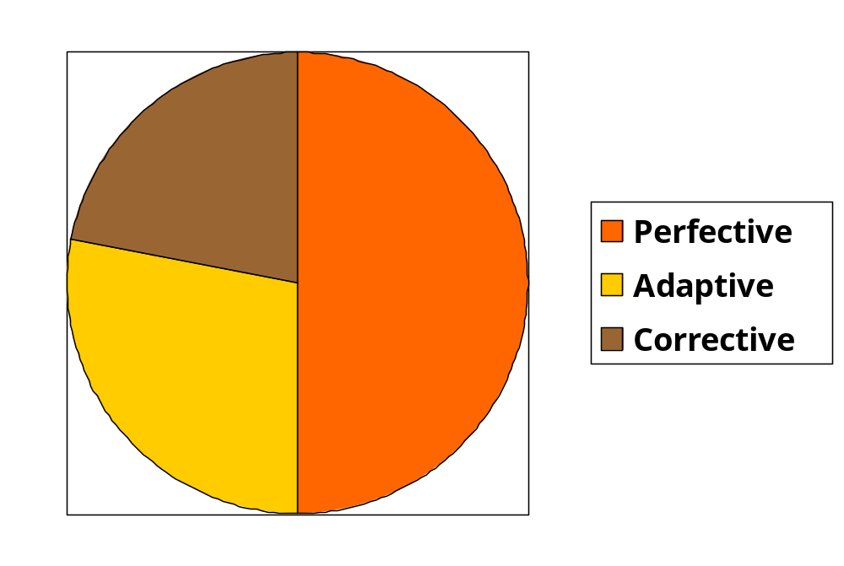
Maintenance Effort Distribution

Slide 10
Causes for maintenance
Users want existing software to run on new platforms:
  to run in new environments,
  and/or with enhanced features.

Slide 11
Causes for maintenance
Whenever other software it works with change:
  maintenance is needed to cope up with the newer interface.
  For instance, a software product may need maintenance when the operating system changes.

Slide 12

Laws of Maintenance
There will always be a lot
of old software needing
maintenance.
Good products are
maintained, bad products
are thrown away.

Slide 13
Laws of Maintenance
Lehman’s first Law:
“Software products must change continuously, or become progressively less useful.”

Slide 14
Laws of Maintenance
Lehman’s Second Law
“When software is maintained, its structure degrades,
  unless active efforts are made to avoid this phenomenon.”

Slide 15
Laws of Maintenance
Lehman’s Third Law:
“Over a program’s life time,
  its rate of development is approximately constant.”

Slide 16
Legacy code--- Major maintenance problems
Unstructured code (bad programs)
Maintenance programmers have:
  insufficient knowledge of the system or the application domain.
  Software maintenance has a bad image.
Documentation absent, out of date, or insufficient.

Slide 17
Insufficient knowledge
Maintenance team is usually different from development team.
  even after reading all documents
    it is very difficult to understand why a thing was done in a certain way.
  Also there is a limit to the rate at which a person can study documents
    and extract relevant information

Slide 18
Bad image of maintenance?
Maintainers are skilled not only in writing code:
  proficient in understanding others’ code
  detecting problems, modifying the design, code, and documentation
  working with end-users

Slide 19
Maintenance Nightmares
Use of gotos
Lengthy procedures
Poor and inconsistent naming
Poor module structure
Weak cohesion and high coupling
Deeply nested conditional statements
Functions having side effects

Slide 20
How to do better maintenance?
Program understanding
Reverse engineering
Design recovery
Reengineering
Maintenance process models

Slide 21
Maintenance activities
Two types of activities:
  Productive activities:
    modification of analysis, design, coding, etc.
  Non-productive activities:
    understanding system design, code, etc.

Slide 22
Software Reverse Engineering
By analyzing a program code, recover from it:
  the design and the requirements specification.

Slide 23
Software Reverse Engineering
In order to extract the design:
  fully understand the code.
Automatic tools can be used to help derive:
  data flow and control flow diagrams from the code.

Slide 24
Software Maintenance Process Model - 1
When the required changes are small and simple:
  the code can be directly modified
  changes reflected in all relevant documents.
  more elaborate activities are required when required changes are not trivial.

Slide 25
Software Maintenance Process Model - 1
Gather Change Requirements
Analyze Change Requirements
Devise Code Change Strategies
Apply Code Change Strategies
Update Documents
Integrate and Test

Slide 26
Software Maintenance Process Model -2
For complex maintenance projects, software reengineering needed:
  a reverse engineering cycle followed by a forward engineering cycle.
  with as much reuse as possible from existing code and other documents.

Slide 27
Maintenance Process Model 2
Preferable when:
  amount of rework is significant
  software has poor structure.
Can be represented by a reverse engineering cycle:
  followed by a forward engineering cycle.

Slide 28
Software reengineering
Forward engineering is carried out to produce the new code.
During design, module specification, and coding:
  substantial reuse is made from the reverse engineered products.

Slide 29
Process model for Software reengineering
Change Requirements
Requirements Specification
New Requirements Specification
Design
Design
Code
Code

Slide 30
Software reengineering
Advantages of reengineering:
  produces better design than the original product,
  produces required documents,
  often results in higher efficiency.

Slide 31
Software reengineering
Reengineering is preferable when:
  amount of rework is high,
  product exhibits high failure rate.
  product difficult to understand.

